Slide 1

The smart way
of thinking
— within HVAC/R and indoor air quality

Slide 2

Mission Statement
“We provide non-metal HVAC/R solutions for air distribution and air dispersion that create outstanding value for our customers, beyond what any traditional or conventional ventilation solution has ever done.
For more than 40 years we’ve refined our technology with two simple ideas in mind: make it better and make it easier.
Our systems are easy to order and easy to install, which
is why our customers consider us reliable and easy to do
business with. We never compromise on quality and always aspire to be superior when it comes to design and service.”

Slide 3
Who is FabricAir?
OUR HISTORY
1973
IPS Ventilation (part of Electrolux)
launches the world’s first Fabric Air
Dispersion System
2002
FabricAir UK is established
2003
FabricAir Lithuania is established and
production is moved to Alytus
1995
FabricAir is ISO 9001 certified
2007
FabricAir Germany is established
1997
FabricAir USA is established

Slide 4
Who is FabricAir?
OUR HISTORY
2008
FabricAir Turkey is established
2017
FabricAir Spain is established
2012
FabricAir Norway is established
2016
FabricAir China is established

Slide 5
FabricAir Products
AIR DISPERSION & AIR DISTRIBUTION

Slide 6
FabricAir Products
UNDERFLOOR DUCTING

Slide 7
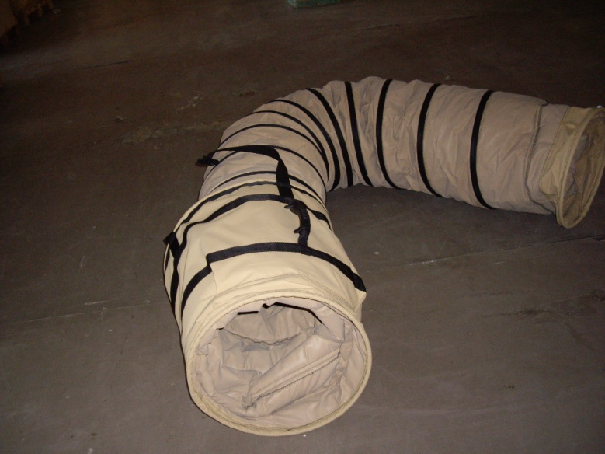
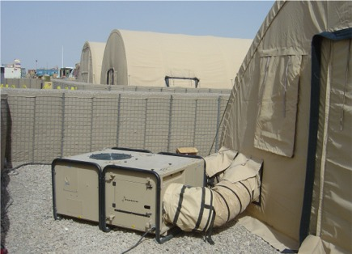
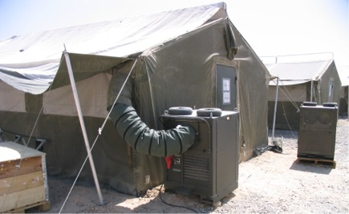
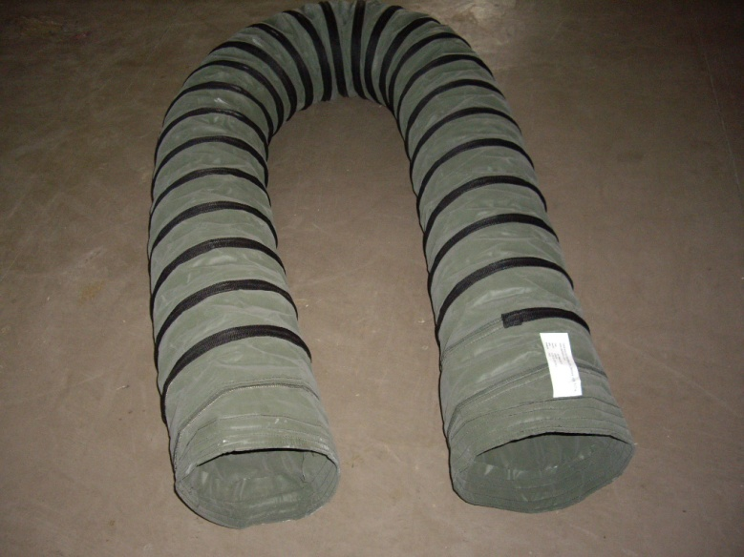
FabricAir Products
INSULATED DUCTS

Slide 8
FabricAir Products
LAYFLAT DUCTS

Slide 9
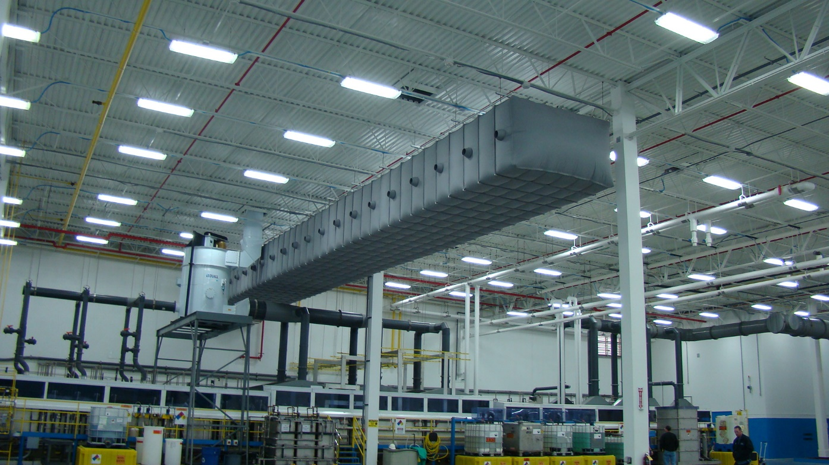
FabricAir Products
CUSTOM DUCT PROFILES

Slide 10
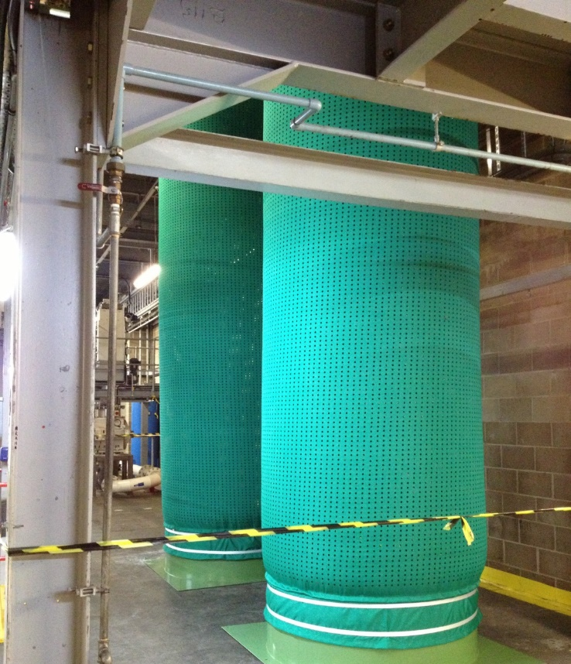
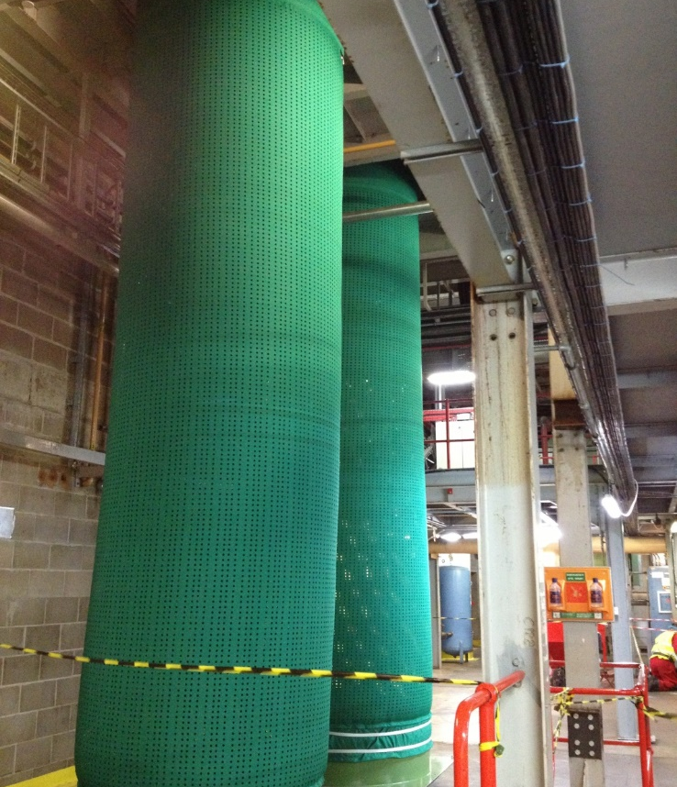
FabricAir Products
DROP DIFFUSERS

Slide 11
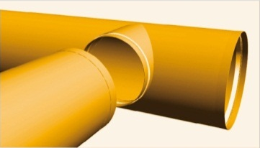
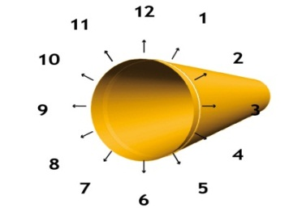
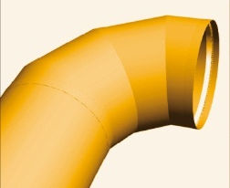
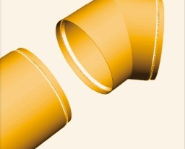
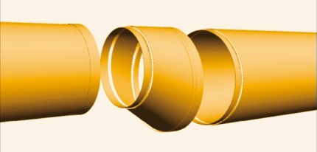
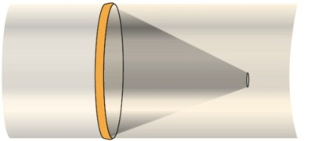
Why Fabric Duct?
DESIGN
DESIGN FREEDOM
FREEDOM
If you can do it in conventional ducting you can do it in fabric ducting.
Outlet branch
Location of outlet flow models are flexible
Elbows
Reductions and transitions
Cones are most often not needed
Notes:
…some features are similar to conventional ducting
Elbows – made with the exact angle desired. There are no restrictions as to direction or dimensions.
Reductions and transitions (all transitions and reductions are made in fabric). Based on the suspension system chosen, the optimum transitions and reductions are selected.
Outlet branch – transition from a main duct to a side duct through an outlet branch.
Location of outlet flow models are flexible around the circumference.
Cones are optional. Cones are most often not needed.

Slide 12
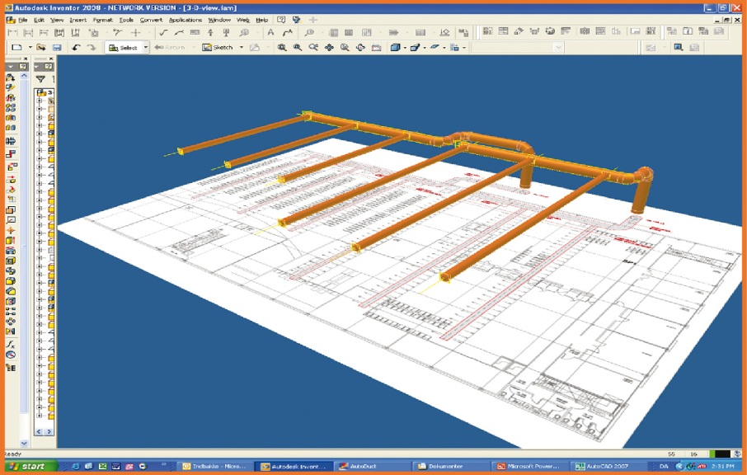
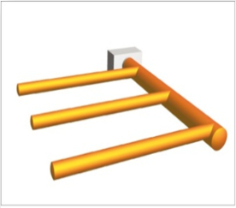
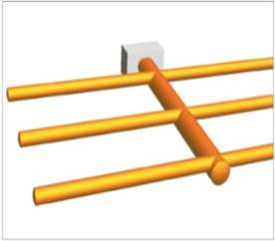
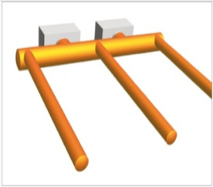
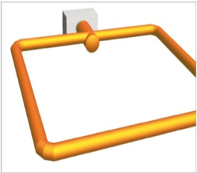
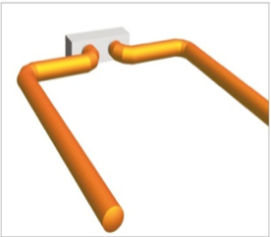
Why Fabric Duct?
DESIGN FREEDOM
DESIGN FREEDOM
The design of fabric systems varies from job to job
– the possibilities are endless.
Notes:
System design is flexible
Because fabric ducts are not composed of fixed bends, elbows and lengths, the product offers complete freedom in design.
…more
The fabric systems are dimensioned and constructed based on online 3D drawing and configuration tools.

Slide 13
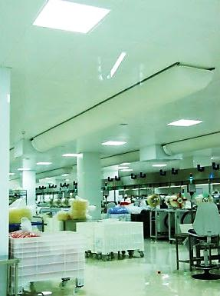
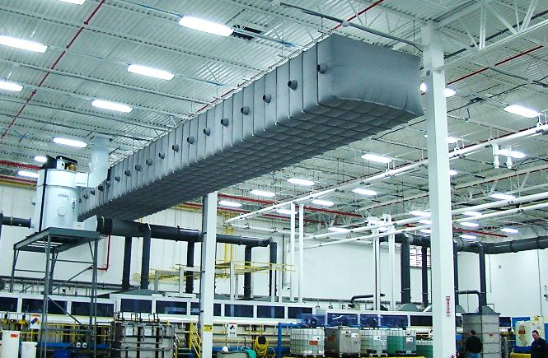
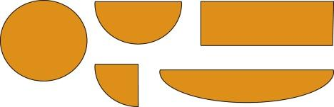
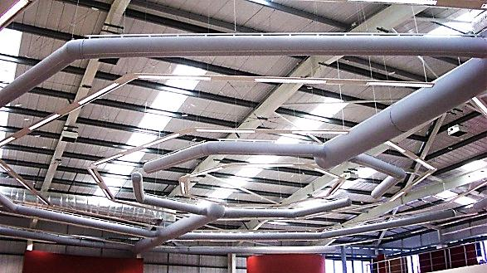
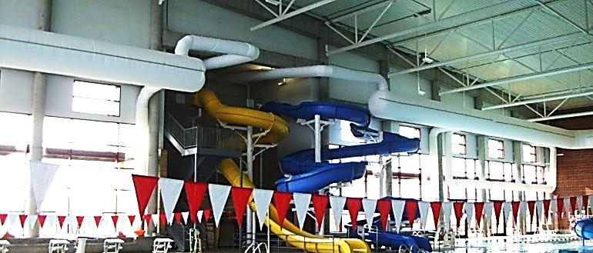
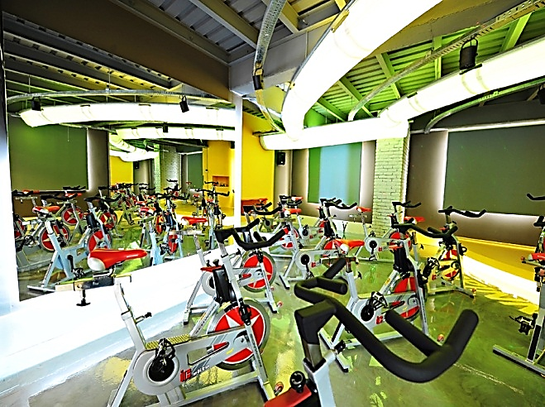
Why Fabric Duct?
DESIGN FREEDOM
DESIGN FREEDOM
Fabric Ducts Can Be Designed With Different Shapes
Notes:
System design is flexible
…in most cases the versatility is greater.
…more
The design of fabric systems varies from job to job – the possibilities are endless. It is easy to create fabric systems fitting the layout of the building perfectly. Naturally, the systems are supplied with both elbows, main and side ducts, reductions etc. Since a fabric system does not require balancing, the need for dampers is minimized and the design work is simplified – while the indoor climate is optimized.

Slide 14
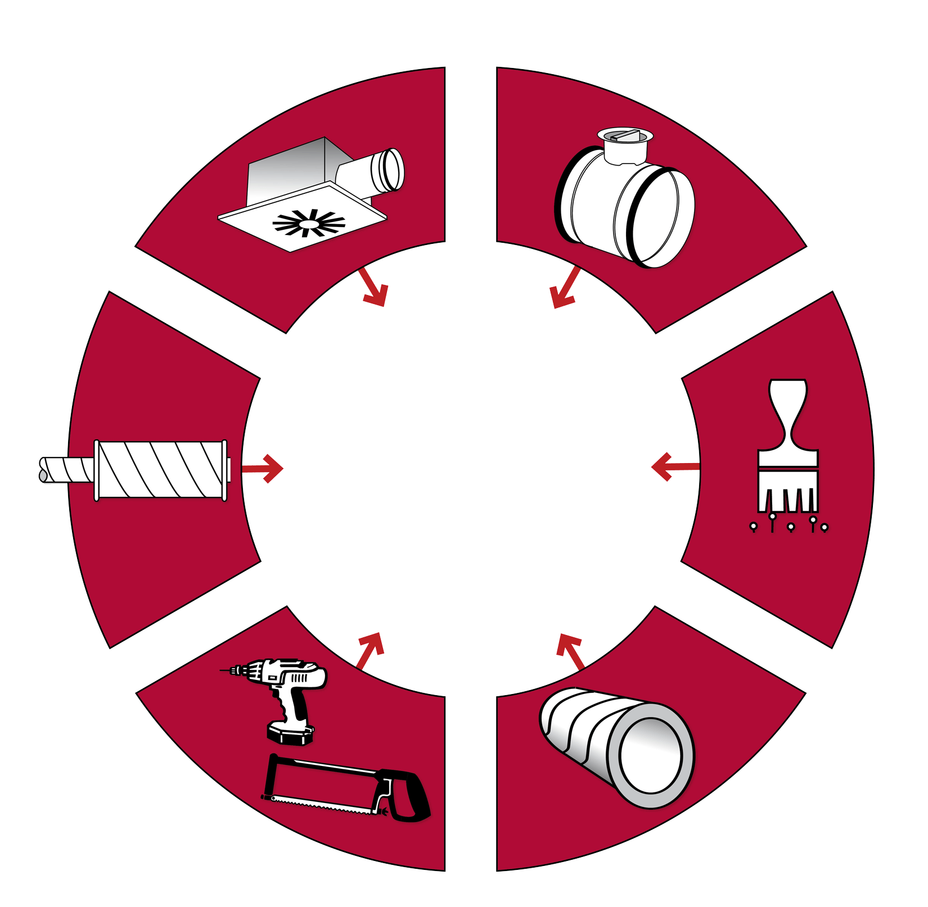
Why Fabric Duct?
COST
COST ADVANTAGE
ADVANTAGE
COST ADVANTAGE
No extra grills or diffusers are necessary
No damper is necessary
All fully integrated in a FabricAir System
No extra noise reduction is needed
Painting is not necessary
No inconvenient shortenings or assembly on site
No extra insulation is necessary
Notes:
Skip conventional thinking
Many functions known from conventional metal ducts are fully integrated in a fabric system. Diffusers, grilles, dampers etc. are completely redundant. A fabric system is all inclusive.
No extra grills or diffusers are necessary. The fabric system functions both as a duct system and as an air dispersion system.
No damper is necessary. A fabric system does not require balancing.
Painting is not necessary. The fabrics are dyed.
No extra insulation is necessary. A fabric system is condensation free.
No inconvenient shortenings or assembly on site. A fabric system fits straight from the factory, is assembled with zippers and is ready for suspension as soon as it arrives.
No extra noise reduction is needed (except perhaps reduction of fan noise). Noiseless is the standard.

Slide 15
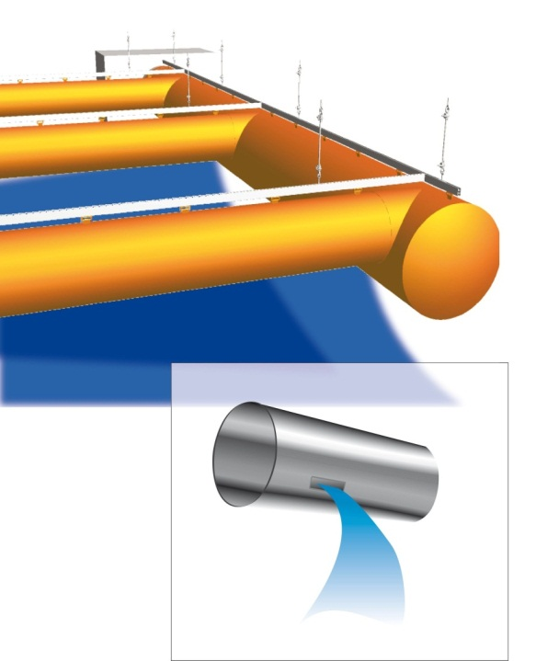
Why Fabric Duct?
AIR DISPERSION
HOMOGENITY
AIR DISPERSION HOMOGENITY
The air is evenly distributed throughout the length of the fabric system.
Dead Zones Are Eliminated by using an Air Dispersion System, the entire system is a diffuser.
Conventional ducts distribute air at certain points i.e. via diffusers.

Slide 16

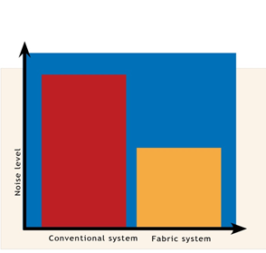
Why Fabric Duct?
Why Fabric Duct?
SILENT
SILENCE
WORKING
Reduced noise level
Maximum level for TV Studios; 25 dB(A)

Slide 17
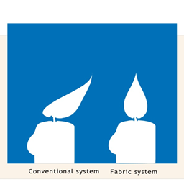
Why Fabric Duct?
FLOW
SPEED
FLOW SPEED
In Fabric Ducts;
Flow speeds are very low and adjustable
No
Draft

Slide 18
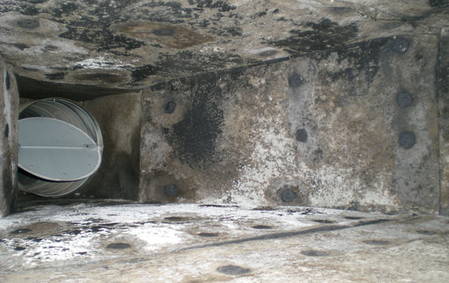
Why Fabric Duct?
HYGIENE
HYGIENE
Hygiene level is Far Better Than Conventional Metal Ducts
◼ Antibacterial
◼ No Condensation
◼ No Need For Insulation
◼ Washable

Slide 19
Why Fabric Ducting?
FabricAir Fabric Ducts
®
COST SAVINGS
◼ The installation time is 4-5 times quicker than conventional metal systemss
◼ On average our customers save 100 hours per project due to the ease of installation
◼ On average that means we have saved contractors more than 77,000 work days last year
◼ On a typical installation, a contractor can save a minimum of 70% on installation time

Slide 20
Why Fabric Air?
FabricAir Fabric Ducts
®
COMPANY FACTS
◼ We invented facric ducting in 1973
◼ We apply high-tech laser cutting technology, which cuts 1,000 holes per second
◼ We tailor 1 million meters of ducting a year and process 1.2 million m² fabric a year
◼ We deliver on time with 99.4% punctuality and with an impressive lead time of <13 days from order release to arrival on job site

Slide 21
Why Fabric Ducting?
FabricAir Fabric Ducts
®
ENERGY
◼ Fabric ducting is an energy friendly alternative to conventional metal solutions
◼ The lower pressure loss saves up to 30% on your energy bill
◼ Expected lifespan of a fabric solution is more than 30 years, in fact some of the original 1970’s ducts are still in use
◼ The compact nature of the fabric ensures 21.3 times less CO2 emissions from transportation than an equivalent solution in metal

Slide 22
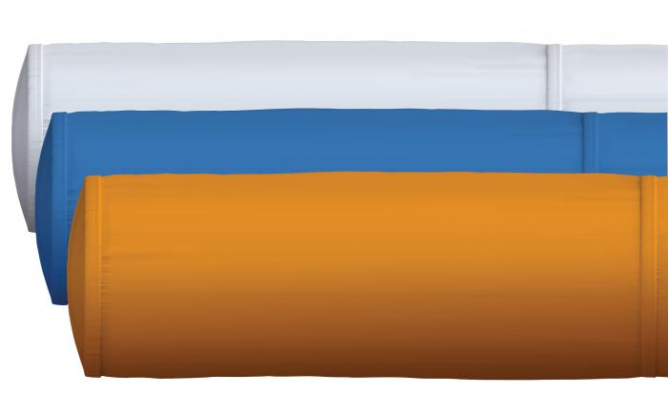
Products
SUSPENSION
FABRICS
TYPES
FabricAir® Trevira is a permeable fabric and comes in 3 variants.
It is suitable in places where there is a risk of bacteria growth or condensation, such as the food industry or indoor pools.

Slide 23
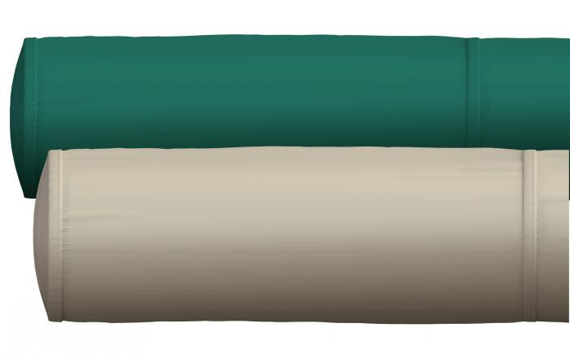
Products
SUSPENSION
FABRICS
TYPES
FabricAir® Combi is available in 8 variants with both permeable and non-permeable fabric.
The fabric is strong and durable – fabric variants come with a 5 or 10 year warranty.

Slide 24
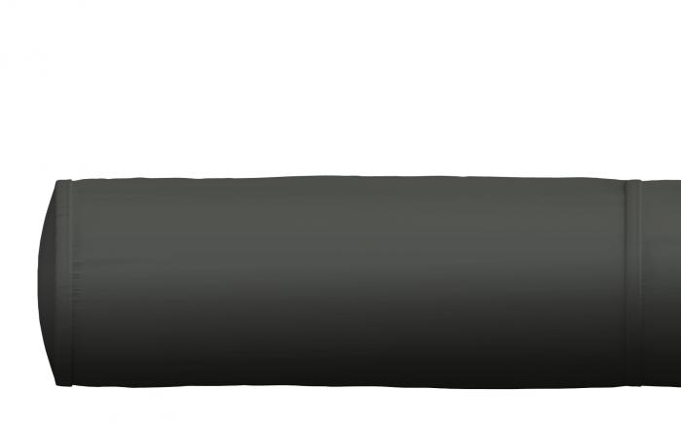
Products
SUSPENSION
FABRICS
TYPES
FabricAir® Lite is available as
non-permeable fabric in 4 variants.
The fabric is strong and durable –
anti-microbial and anti-static features
are optional.

Slide 25
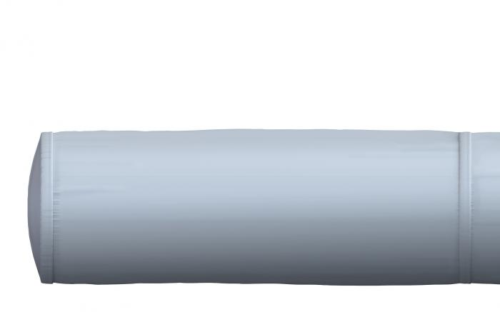
Products
SUSPENSION
FABRICS
TYPES
FabricAir® Glass 220 is
non-combustable and non-permeable.

Slide 26
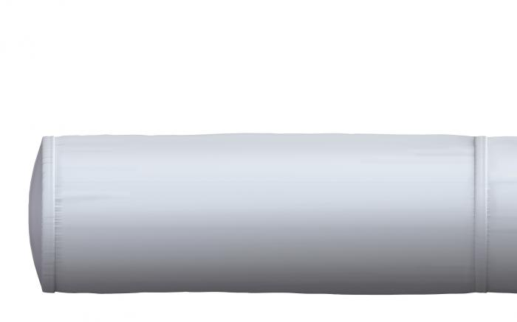
Products
SUSPENSION
FABRICS
TYPES
FabricAir® Poly is a non-permeable fabric, mainly used in heavy industrial installations for distributing isothermal or heated air.

Slide 27
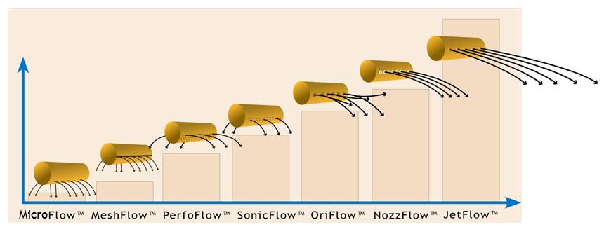
Products
FLOW
MODELS
FLOW MODELS
Different Flow Models for different Applications

Slide 28
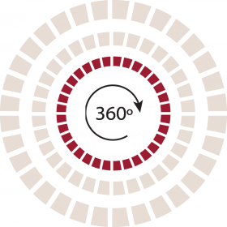
Products
SUSPENSION
SUSPENSION TYPES
FLOW MODELS
TYPES
In FabFlow™ the air exits the duct through the permeable fabric surface.
The air is driven by thermodynamic forces preventing drafts in the occupied zone, which results in a high level of comfort.

Slide 29
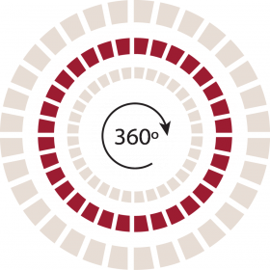

Products
SUSPENSION
SUSPENSION TYPES
FLOW MODELS
TYPES
With MicroFlowTM the air exits the duct via laser cut micro-perforations along the circumference of the duct.
The micro-perforations can cover between 90° and 360° of the duct’s circumference. MicroFlowTM has the smallest near-zone of all of the perforated fabrics available.
In most cases the near-zone will not extend beyond 300 mm [11.81”].

Slide 30
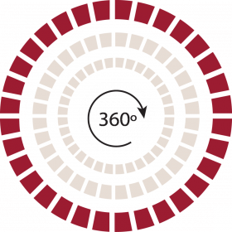

Products
SUSPENSION
SUSPENSION TYPES
FLOW MODELS
TYPES
With PerfoFlowTM the air exits the duct via laser cut perforations along the circumference of the duct.
The perforations can cover between 90° and 360° of the duct’s circumference.
The size of the near zone depends on the static pressure inside the duct, the percentage of the circumference that is perforated, and the size and spacing of the perforations.

Slide 31
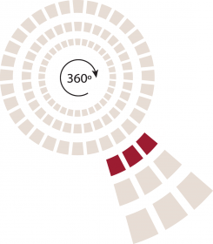

Products
SUSPENSION
SUSPENSION TYPES
FLOW MODELS
TYPES
SonicFlowTM is a directional flow model where the air exits the duct via rows of laser cut perforations.
Multiple rows of SonicFlowTM can be specified for a duct, with each row covering a maximum of 30° of the circumference.
The throw depends on the static pressure inside the duct, the size, and spacing of the perforations.

Slide 32

Products
SUSPENSION
SUSPENSION TYPES
FLOW MODELS
TYPES
OriFlowTM is a directional flow model where the air exits the duct via rows of laser cut orifices.
Multiple rows of OriFlowTM can be specified for a duct.
The throw depends on the static pressure inside the duct, the size, and spacing of the orifices.

Slide 33
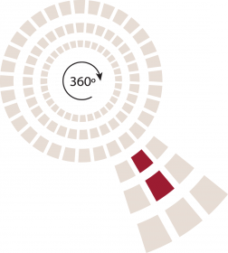

Products
SUSPENSION
SUSPENSION TYPES
FLOW MODELS
TYPES
NozzFlowTM is used in applications where very precise directional airflow is needed.
The discharge coefficient is almost at unity due to the shape of the nozzle.
This results in higher discharge velocities than an equivalently sized orifice, and longer more directional throws.

Slide 34
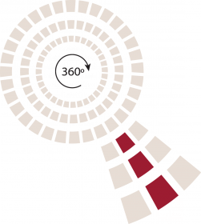

Products
SUSPENSION
SUSPENSION TYPES
FLOW MODELS
TYPES
JetFlowTM is capable of generating exceptionally long throws through the use of conical jets in varying diameters.
The jets have a very high discharge coefficient due to the conical shape.
This results in higher discharge velocities than an equivalently sized orifice.

Slide 35
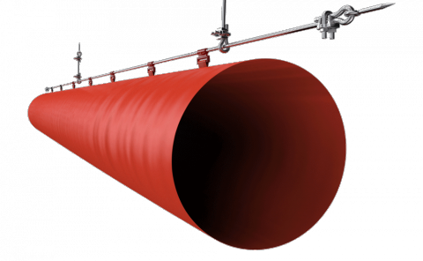
Products
SUSPENSION
SUSPENSION TYPES
TYPES
Type 1 / Type 1 AIO
Simple on straight runs
Inexpensive
Available in galvanized and stainless steel
Available with All-in-One

Slide 36
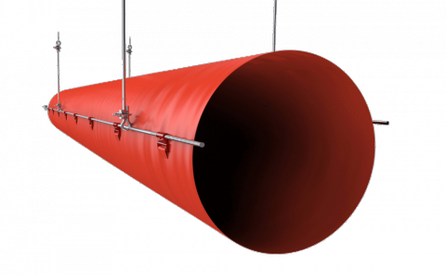
Products
SUSPENSION
SUSPENSION TYPES
TYPES
Type 2
Great for larger diameters
Simple on straight runs
Inexpensive
Available in galvanized and stainless steel

Slide 37
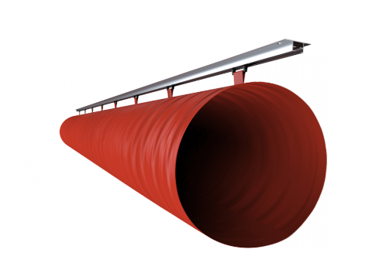
Products
SUSPENSION
SUSPENSION TYPES
TYPES
Type 3 / Type 3 AIO
Quick and easy installation for regular ceilings
Easy removal for frequently washed applications
Inexpensive
Available with All-in-One

Slide 38
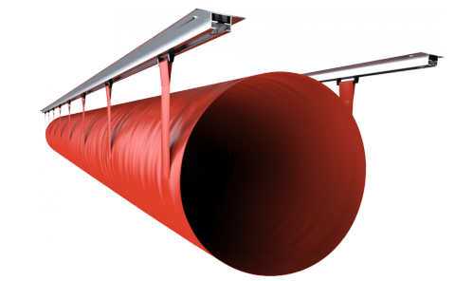
Products
SUSPENSION
SUSPENSION TYPES
TYPES
Type 4
Great for larger diameters
Easy removal for frequently washed applications
Inexpensive

Slide 39
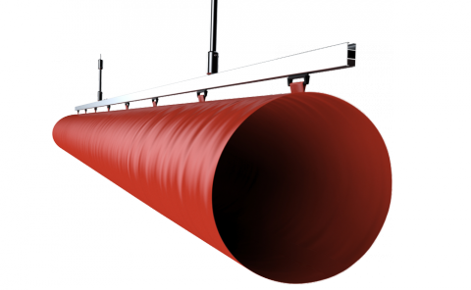
Products
SUSPENSION
SUSPENSION TYPES
TYPES
Type 5 / Type 5 AIO
Aesthetically pleasing installation
Stable installation
Available with All-in-One

Slide 40
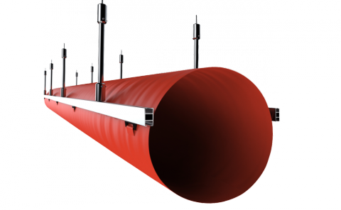
Products
SUSPENSION
SUSPENSION TYPES
TYPES
Type 6
Aesthetically pleasing installation
Stable installation
Great for larger diameters

Slide 41
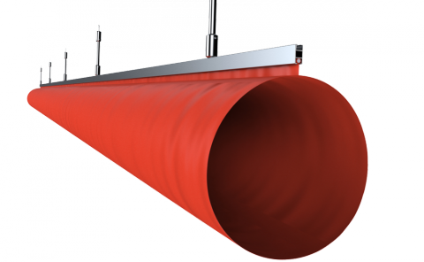
Products
SUSPENSION
SUSPENSION TYPES
TYPES
Type 7
Aesthetically pleasing installation
Stable installation

Slide 42
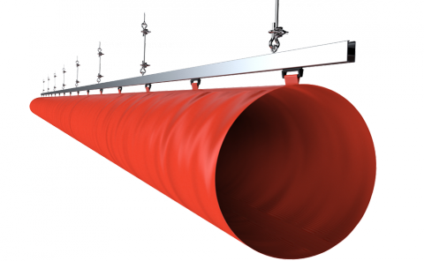
Products
SUSPENSION
SUSPENSION TYPES
TYPES
Type 8 / Type 8 AIO
Our most versatile system
Excellent for vertical and complicated systems
No seismic requirements in most areas
Available with All-in-One

Slide 43

Products
SUSPENSION
SUSPENSION TYPES
TYPES
Type 11 / Type 11A
Great for low ceiling heights
Aesthetically pleasing installation

Slide 44

Products
SUSPENSION
SUSPENSION TYPES
TYPES
Type 12
Great for low ceiling heights
Great for frequently washed applications
Inexpensive

Slide 45

Products
SUSPENSION
SUSPENSION TYPES
TYPES
Type 13
Aesthetically pleasing installation
Flexible in high ceiling heights
Great for larger diameters
Stable installation
Great for frequent wash applications

Slide 46
Applications
SUSPENSION
TYPES
◼ FOOD
◼ SPORT
◼ INDUSTRIAL
◼ RETAIL & PUBLIC AREAS
◼ EDUCATIONAL, OFFICES & COMFORT
◼ MEDICAL INDUSTRY

Slide 47


Slide 48


Slide 49


Slide 50


Slide 51


Slide 52


Slide 53


Slide 55


Slide 56


Slide 57


Slide 58


Slide 59


Slide 61


Slide 62


Slide 63


Slide 64

LOOK UP FOR A CHANGE

